Slide 1

Book cover
The Agentic Organisation
EUROPEAN EDITION
European businesses are dangerously underprepared for the largest paradigm shift since the industrial revolution. This book is the definitive guide to AI transformation—a practical guidebook for CEOs and leadership teams to benefit from the opportunities AI provides, set in the European context.
THE AGENTIC ORGANISATION
A complete guide for AI transformations
European businesses are dangerously underprepared for the largest paradigm shift since the industrial revolution. This book is the definitive guide to AI transformation—a practical guidebook for CEOs and leadership teams to benefit from the opportunities AI provides, set in the European context.
European businesses are dangerously underprepared for the largest paradigm shift since the industrial revolution. This book is the definitive guide to AI transformation—a practical guidebook for CEOs and leadership teams to benefit from the opportunities AI provides, set in the European context.
Stephan Hartgers-Rus

Slide 2
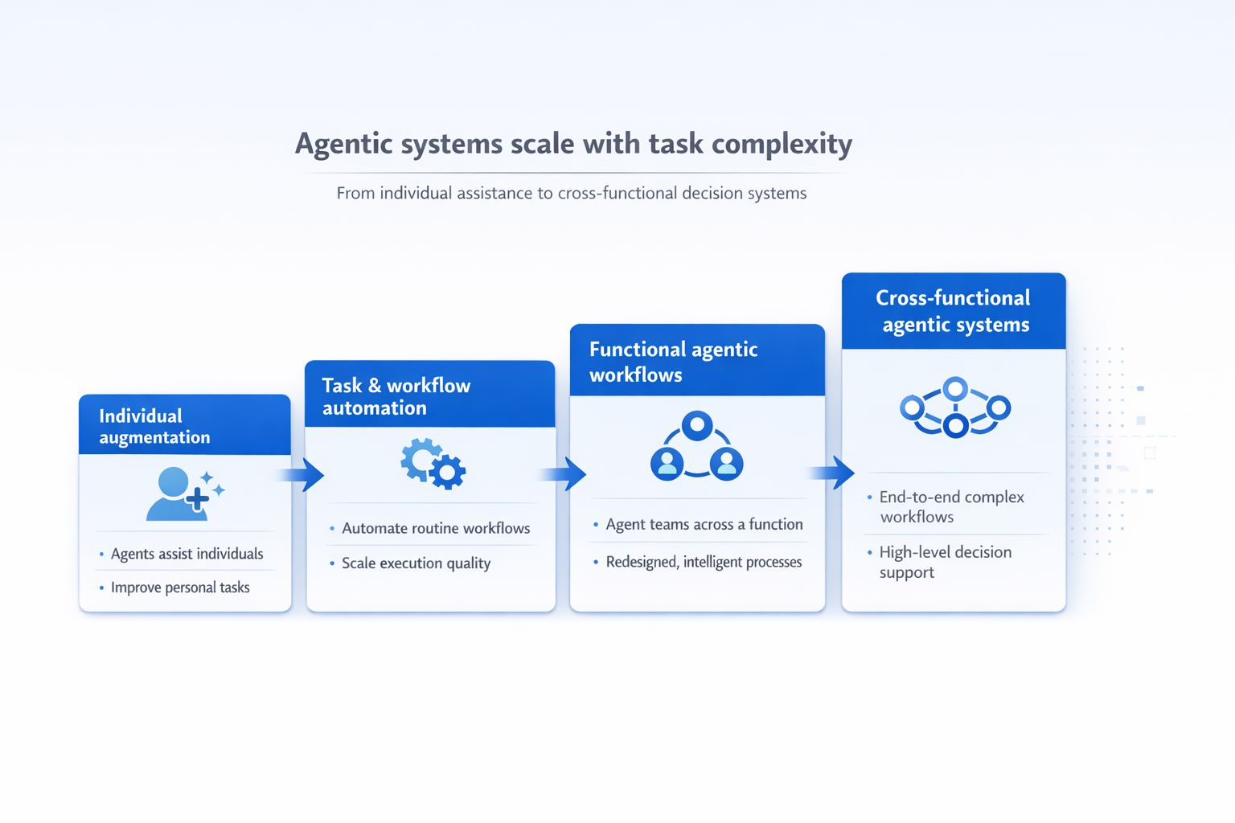
Agentic systems scale with task complexity
Cross-functional agentic workflows
Functional agentic workflows
Task & workflow automation
Individual augmentation
Agents assist individuals
Improve personal tasks
Automate routine workflows
Scale execution quality
Agent teams across a function
Redesign, intelligent processes
End-to-end complex workflows
High-level decision support

Slide 3
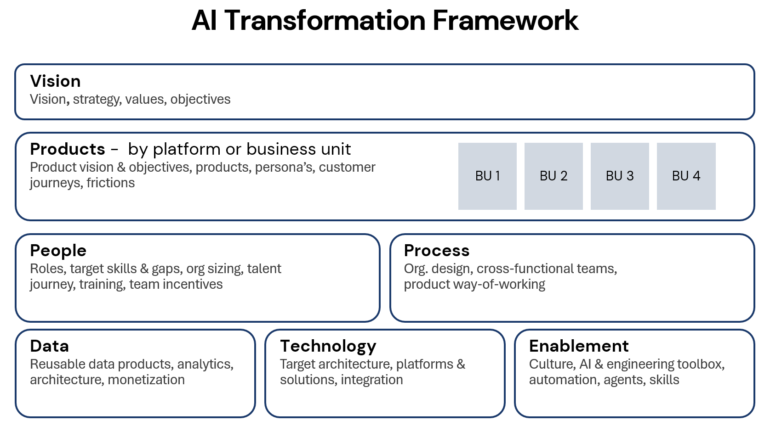
AI Transformation Framework
VISION
Vision, strategy, values, objectives
PRODUCTS - by business unit
Product vision & objectives, products, persona’s, customer journeys, frictions
BU 1
BU 2
BU 3
BU 4
PEOPLE
Roles, target skills & gaps, org sizing, talent journey, training, team incentives
PROCESS
Org. design, cross-functional teams, product way-of-working
ENABLEMENT
Culture, AI & engineering toolbox, automation, agents, skills
DATA
Reusable data products, analytics, architecture, monetization
TECHNOLOGY
Target architecture, platforms & solutions, integration

Slide 4
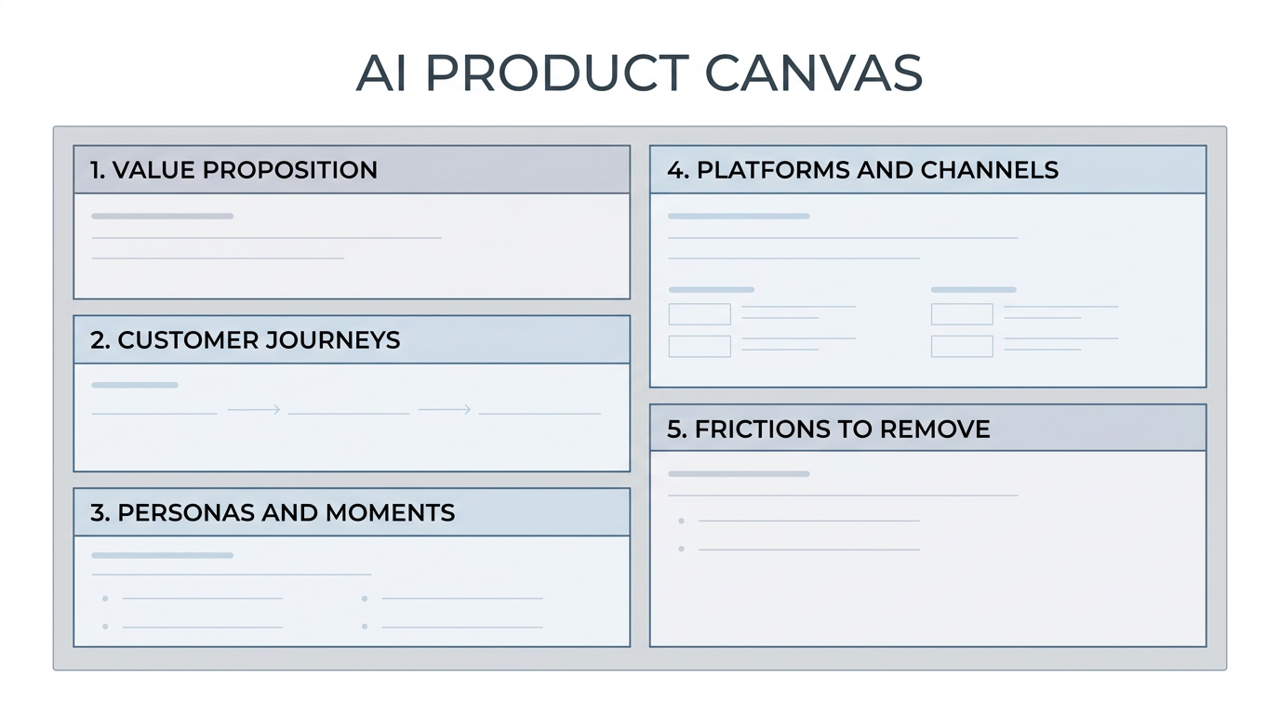
AI Product Canvas

Slide 5
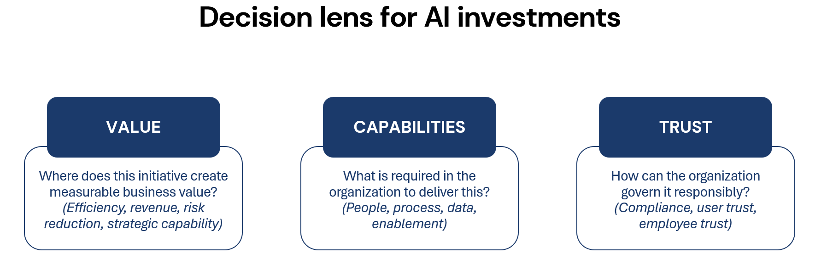
Decision lens for AI investments
VALUE
CAPABILITIES
TRUST
Where does this initiative create measurable business value? (Revenue, efficiency, risk reduction, strategic capability)
What is required in the organisation to deliver this? (People, process, enablement, data, tech)
How can the organisation govern it responsibly? (Compliance, user trust, employee trust)

Slide 6
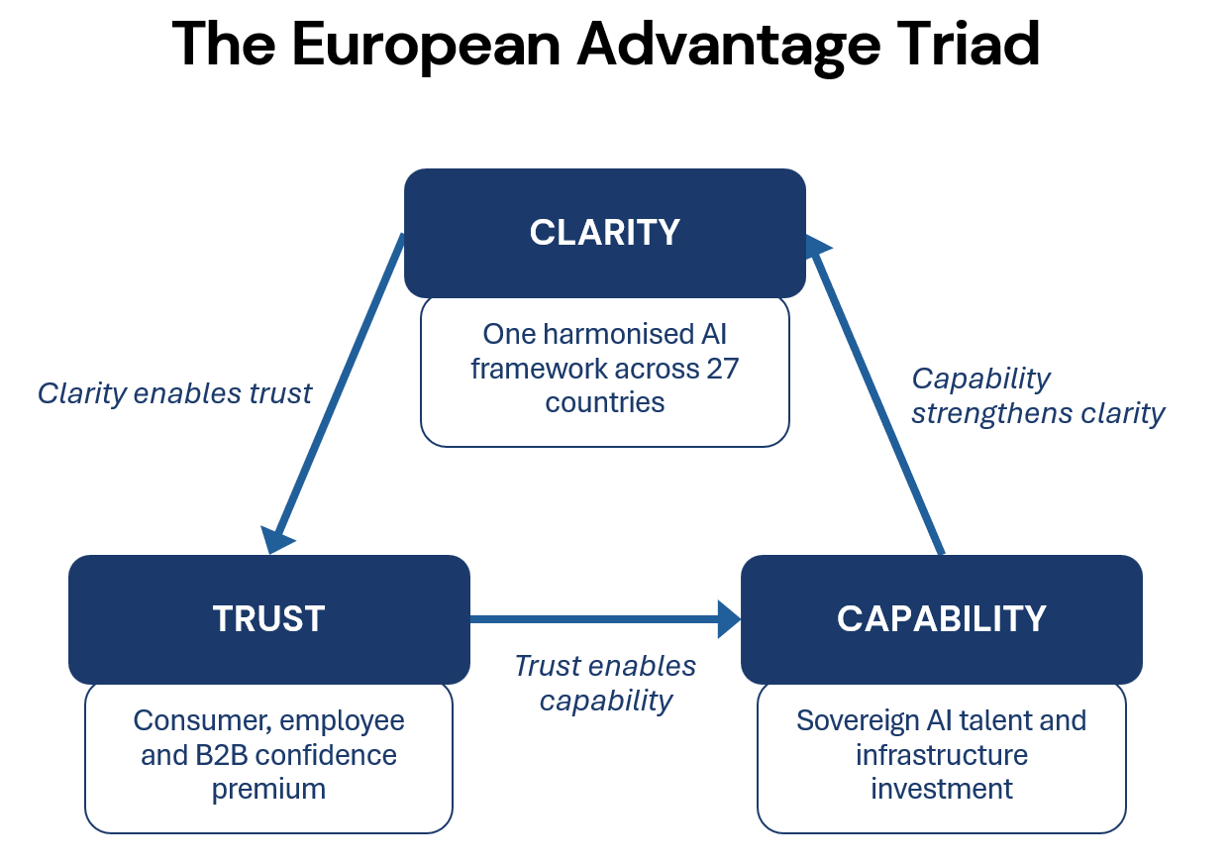
The European Advantage Triad
SINGLE RULEBOOK
Clarity enables trust
One harmonised AI framework across 27 countries
Capability strengthens clarity
TRUST PREMIUM
GOVERNANCE DIVIDEND
Consumer, employee and B2B confidence premium
Trust enables capability
Sovereign AI talent and infrastructure investment

Slide 7
AI Transformation framework for European CEO’s – not used
The Agentic Organisation
Governance & Metrics
Definitions, targets, monitoring, steering
Financials
ROI, cost analysis & optimization, tracking
Implementation
Roadmap, big decisions, change management
Value
Capabilities
Trust

